Slide 1
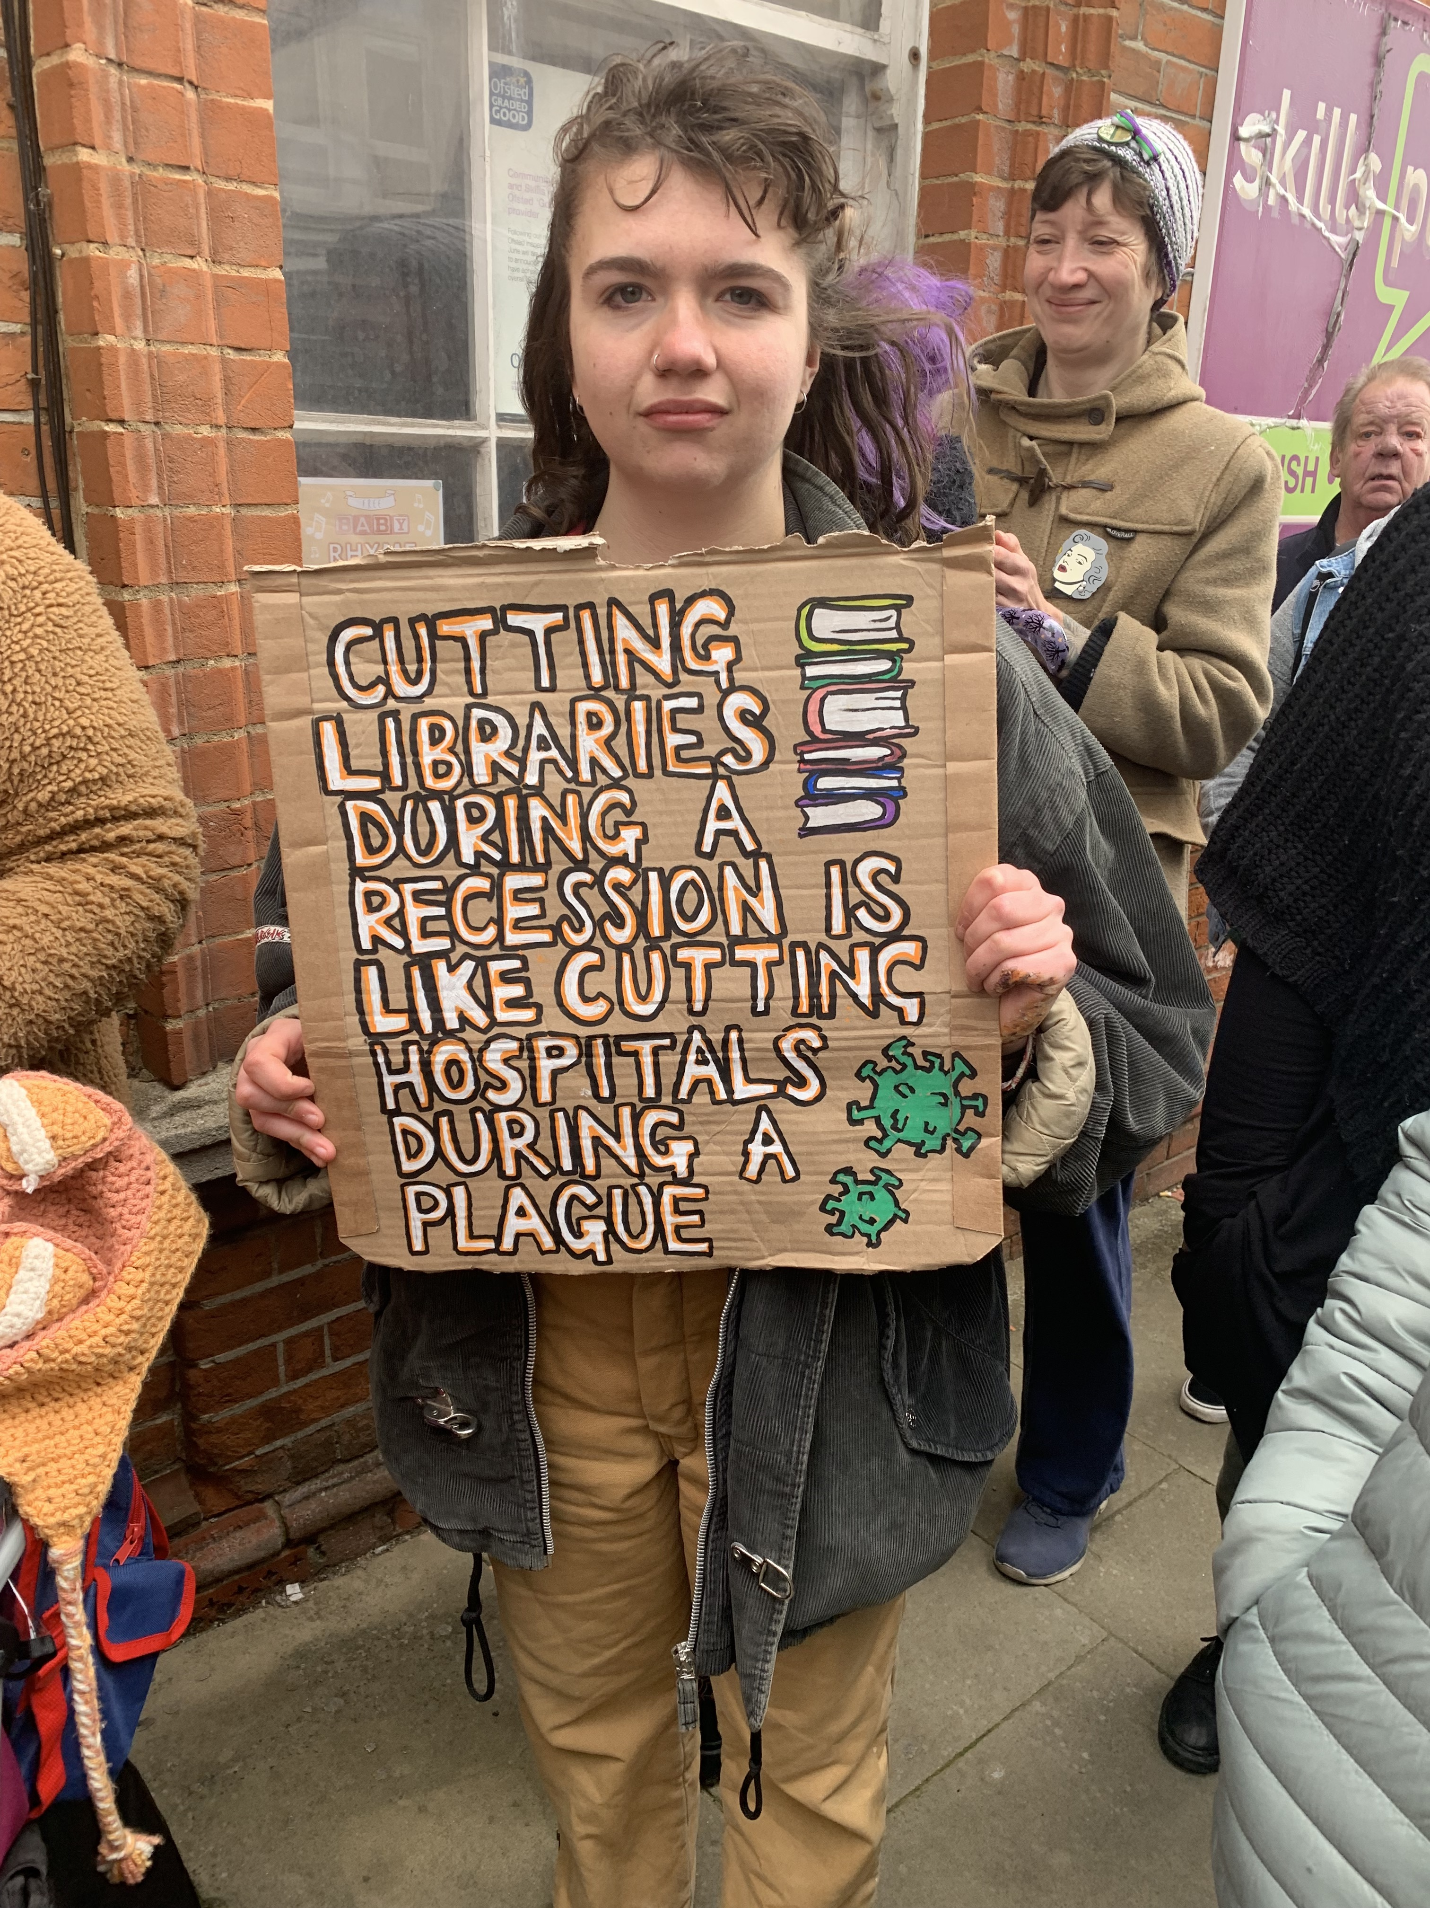
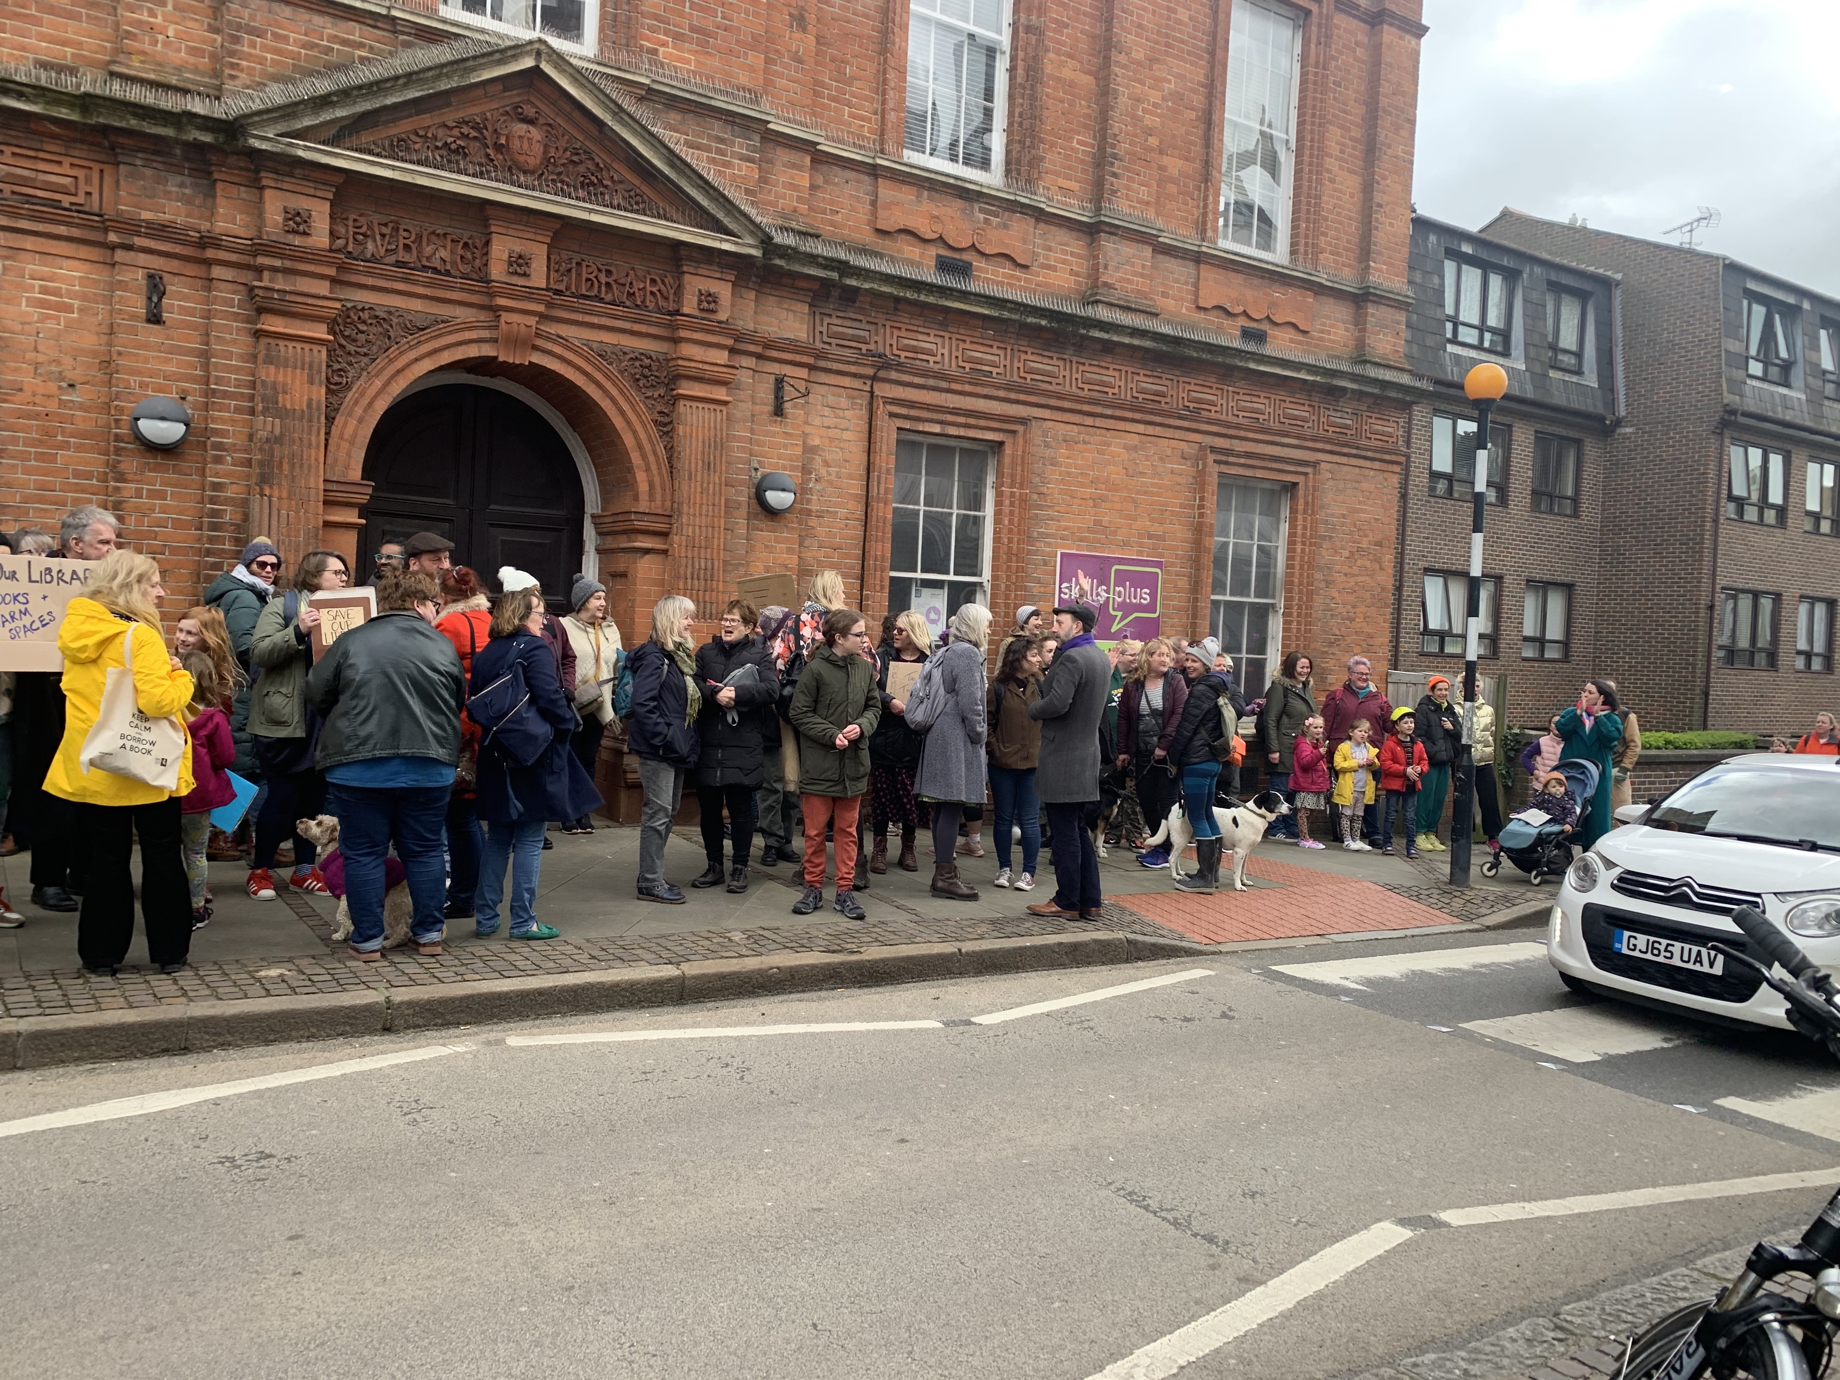
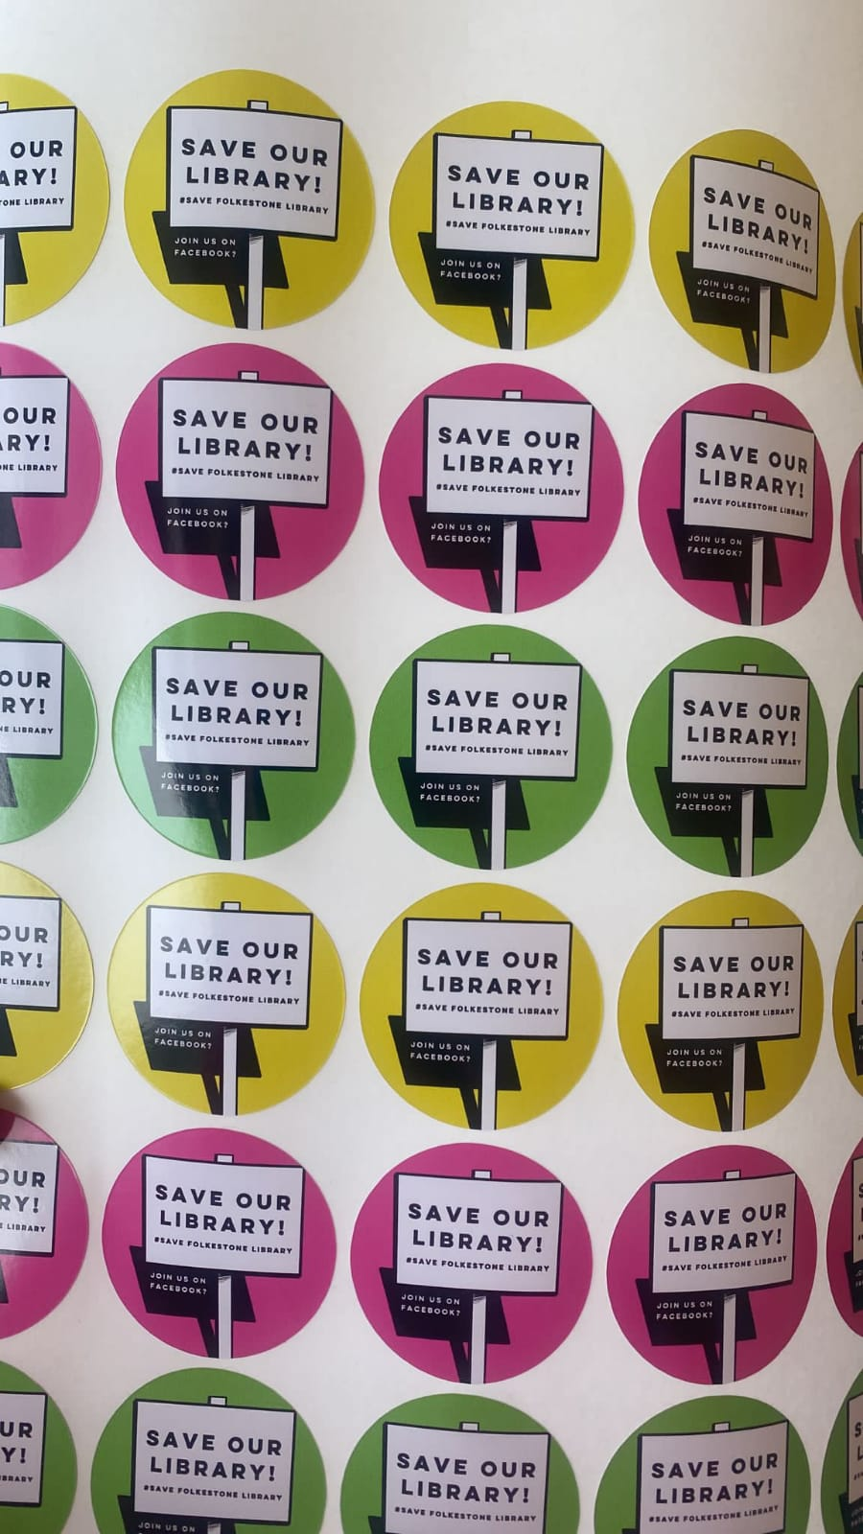
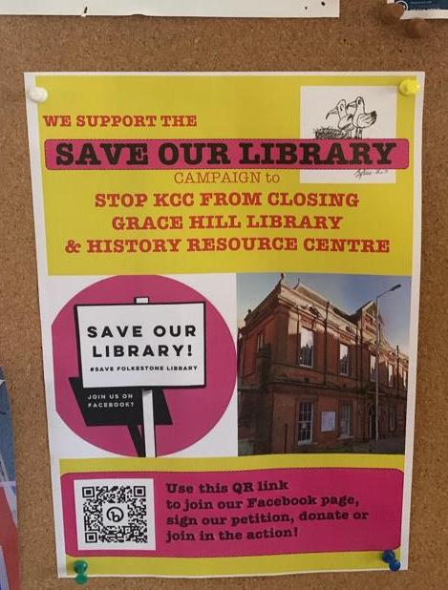
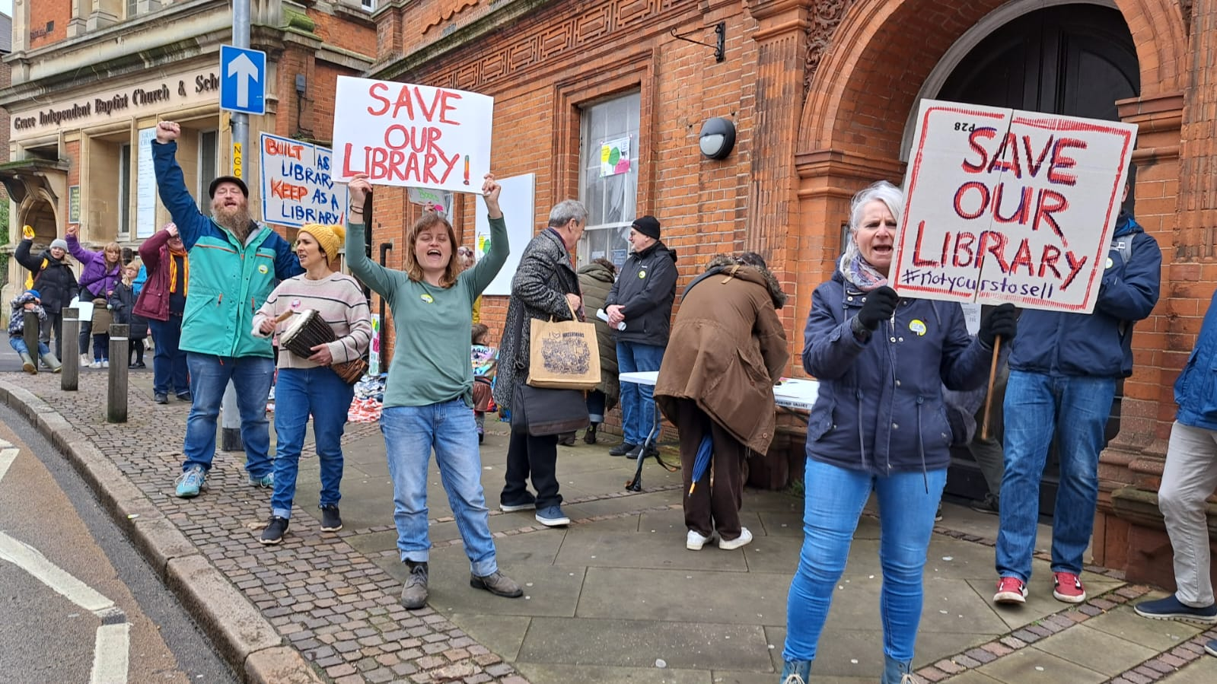
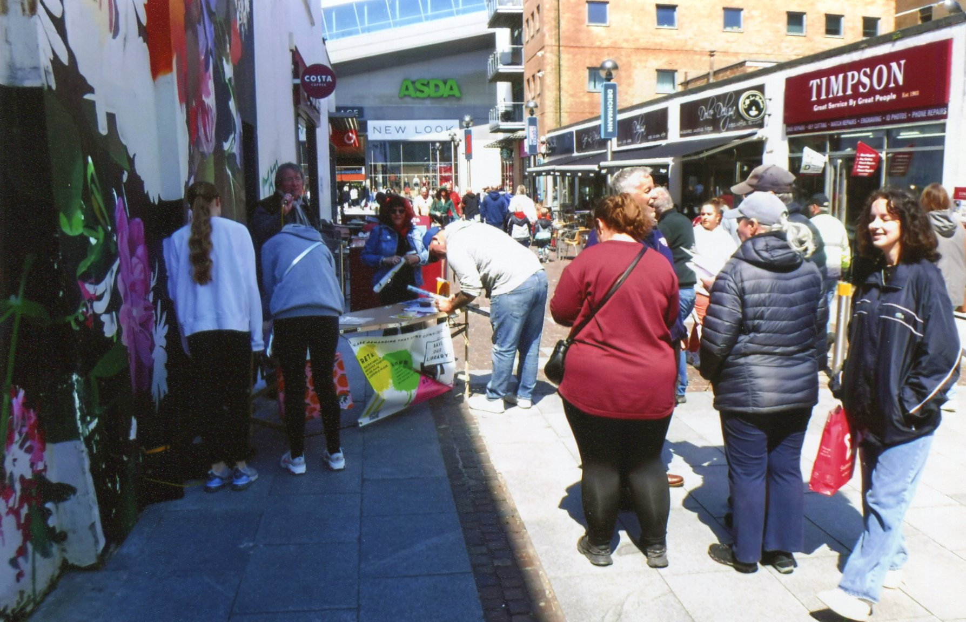
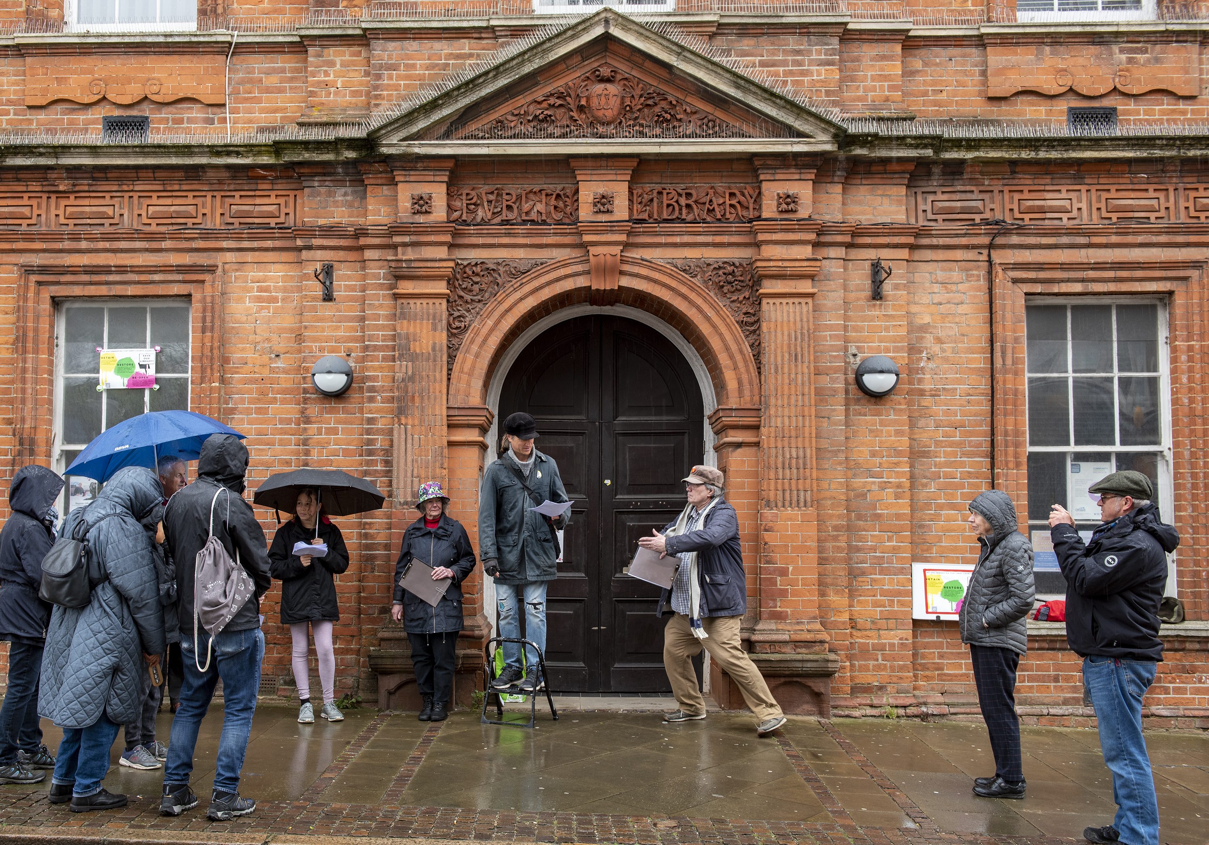
Saving Grace
THE FOLKESTONE COMMUNITY’S SAVE OUR LIBRARY CAMPAIGN

Slide 2
Save our Library: the story so far….
From a standing start in late March, the Folkestone community have come together to support a wide-ranging Save Our Library campaign of protest, petitions, political pressure and publicity.
The result: with the groundswell of popular opinion firmly on our side, we have secured several hard-won concessions from senior politicians – with no compromise on our position.
The local authority, Kent County Council must meet its statutory and moral obligations to provide a properly maintained public library service, making good use of Grace Hill as a key public asset.
We expect nothing less than:
Full disclosure and transparency over the history of library management at Grace Hill
Accountability and communication with local people being engaged in decision making
Consultation on how best to address the issues and to invite contributions towards solutions

Slide 3
SOL Campaign checkpoints: action speaks louder than words…
Animation, arts, civic group, theatre, music & spoken word events Music in May festival support
National Press coverage; Private Eye feature
Links with other national and international campaigns
National Heritage bodies advice and support
Union support
University academics support
Writers’ group support
Parliamentary Question Meetings with key Councillors and with Damien Collins MP
Petition reaching over 3000 signatures
FOI submitted for response from KCC by 20th June
Pre-action legal letter submitted to KCC, for response during July
SOL campaign WhatsApp group of over 80
SOL Facebook page reaching over 1200 followers
SOL in-house design work: posters, stickers, publicity
SOL campaign newsletter
SOL website presence via www.folkest.one
SOL Media including KMTV; BBC South East; Meridian
History blogs, social media presence
Seagull caricature
Weekly Town Centre petition stall
Monthly protest marches & Library rallies;
County Hall Lobby
35+ community groups engaged 50+ shops and businesses displaying SOL posters
Schools’ and children’s letters of support

Slide 4
SOL Campaign Current position
SOL has successfully formed into a broad alliance with a four pronged approach – as above
KCC retain the overarching responsibility for decision making and finding a solution
Damian Collins MP and KCC Folkestone West Cllr Dylan Jeffrey both support the reopening of Grace Hill
KCC Folkestone East Councillor Jackie Meade has been consistent in pressing for action at County Hall
FHDC leadership and Central Town Coucillors are now adding to the calls for action
KCC have issued a series of public statements, very much linked to and in response to SOL actions
KCC Deputy Leader Cllr Peter Oakwood has written to acknowledge failings in maintenance programme
There is a written KCC commitment to continue exploring repairs AND find temporary alternative provision

Slide 5
Next stages
A refresh of the planning team to add new capacity and new dimensions to the campaign
Continuing pressure to secure meaningful negotiations on the future of Grace Hill
Events, activities on a regular basis to support awareness and interest in the campaign
16th June Delivery of the SOL KCC Public Petition
17th June Story of the Library event at Kathmandu restaurant
20th June Schools Love Our Library competition
A three month plan with a target date of solutions emerging by September 1st 2023
Publicity and public visibility as a key tool: media updates; town centre events; online info

